Slide 1
Image matting by Bayesian approach
Name: Rajesh
Roll no: EE21M019
Department : Electrical-SPCOM,Mtech.
Guide : Dr. Subrahmanyam Gorthi.

Slide 2
Introduction
Image Matting is the process of accurately estimating the foreground object in images and videos.
It has a wide range of applications, especially in the field of digital image editing and film production.

Slide 3
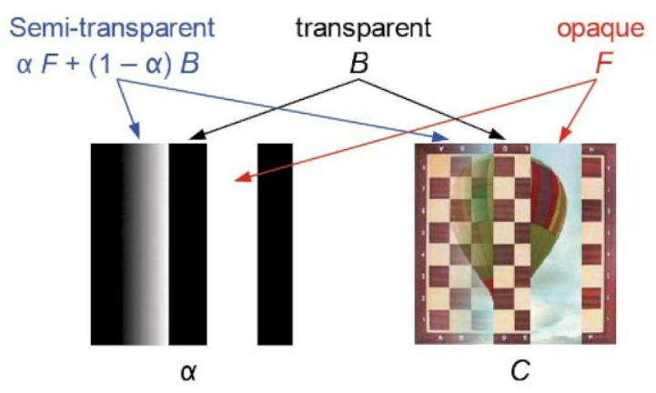
Background
Mathematically, the observed image C is modelled as a combination of foreground image F and background image B by using the alphamatte α:
C=(α)*F+ (1 − α)*B
where α is the pixel's opacity component

Slide 4
Complexity
C=(α)*F+ (1 − α)*B
in this equation, The known information we have for a pixel are the three-dimensional colour vector C, and the unknown variables are the three-dimensional colour vectors F and B, and the scalar alpha value α.
Matting is thus inherently an under-constrained problem, since 7 unknown variables need to be solved from 3 known values.
In this, all unknowns are calculated by using Bayesian approach and maximum a posteriori (MAP) technique.

Slide 5
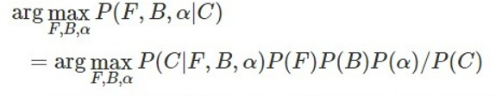

Bayesian Approach
In MAP estimation, we try to find the most likely estimates for F,B, and α, given the observation C.
by bayes rule and assuming F,B, α are independent variables.
Neglecting P(c), as it is a constant, and applying log by representing log p() as L()
P(C|F,B,α) is the measuring the difference between the observed color and the color that would be predicted by the estimated F,B, and α
We assume P(C|F,B,α) is a gaussian distribution and hence
Data term
Prior terms

Slide 6
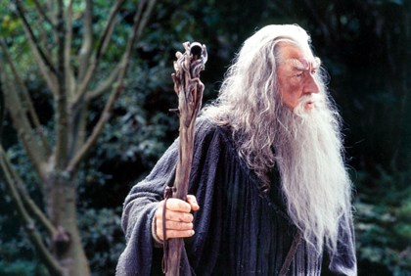

continue
We are given an input image as well as a trimap that indicates pixels which belong surely to the background, surely to the foreground, and a gray area that we need to determine the values of opacity for
Input Image
Trimap

Slide 7


Continue
We fit a gaussian distribution onto foreground and background, the mean and variance of distribution comes from known foreground and background that come from trimap and hence
and similar for L(B)
We assume p(α) as constant, and we calculate F and B from
After obtaining F and B, calculate α by substituting F and B as constant from
We do above two steps iteratively until we get better result.
6x6
6x1
6x1

Slide 8
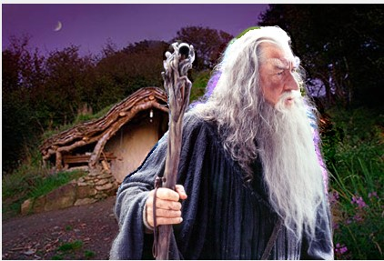
Results
Input Image
Composite Image

Slide 9
Thank You

